Slide 1

PYCAMP 2.0
Day 1

Slide 2
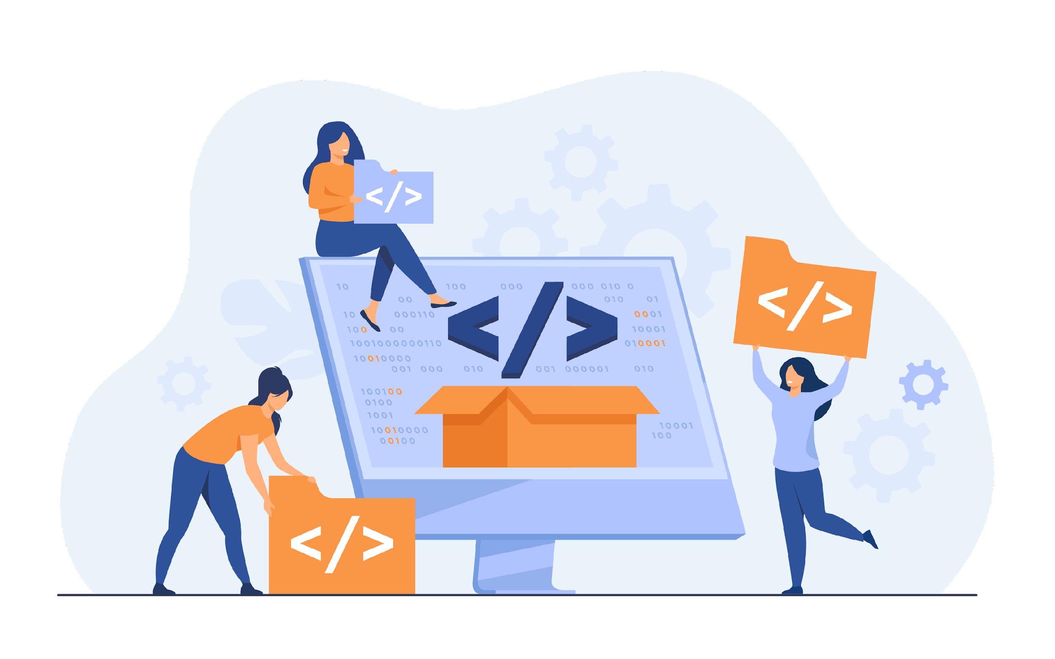
Agenda for Day 1
1
7
What is Python?
Conditional Statements
2
8
About Python
Rock paper scissors game
3
Inputs and Outputs
4
Python Variables
5
Python Data Types
6
Python Operators

Slide 3




What is Python?
Python is an interpreted, object-oriented, high-level programming language
Applications of python -
Web development (server-side)
Software development
AI and machine learning
Data analytics

Slide 4
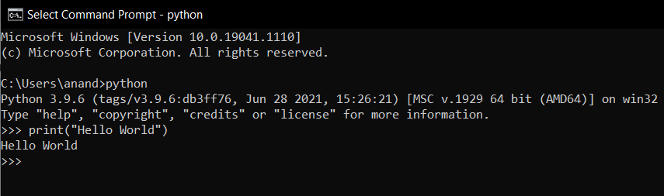
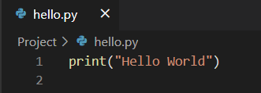
About Python
Easy Syntax
Python has one of the easiest syntax to read and understand
Extension
Python files are saved in *.py format
Types
Interactive Mode Programming, Scripting Mode Programming,

Slide 5
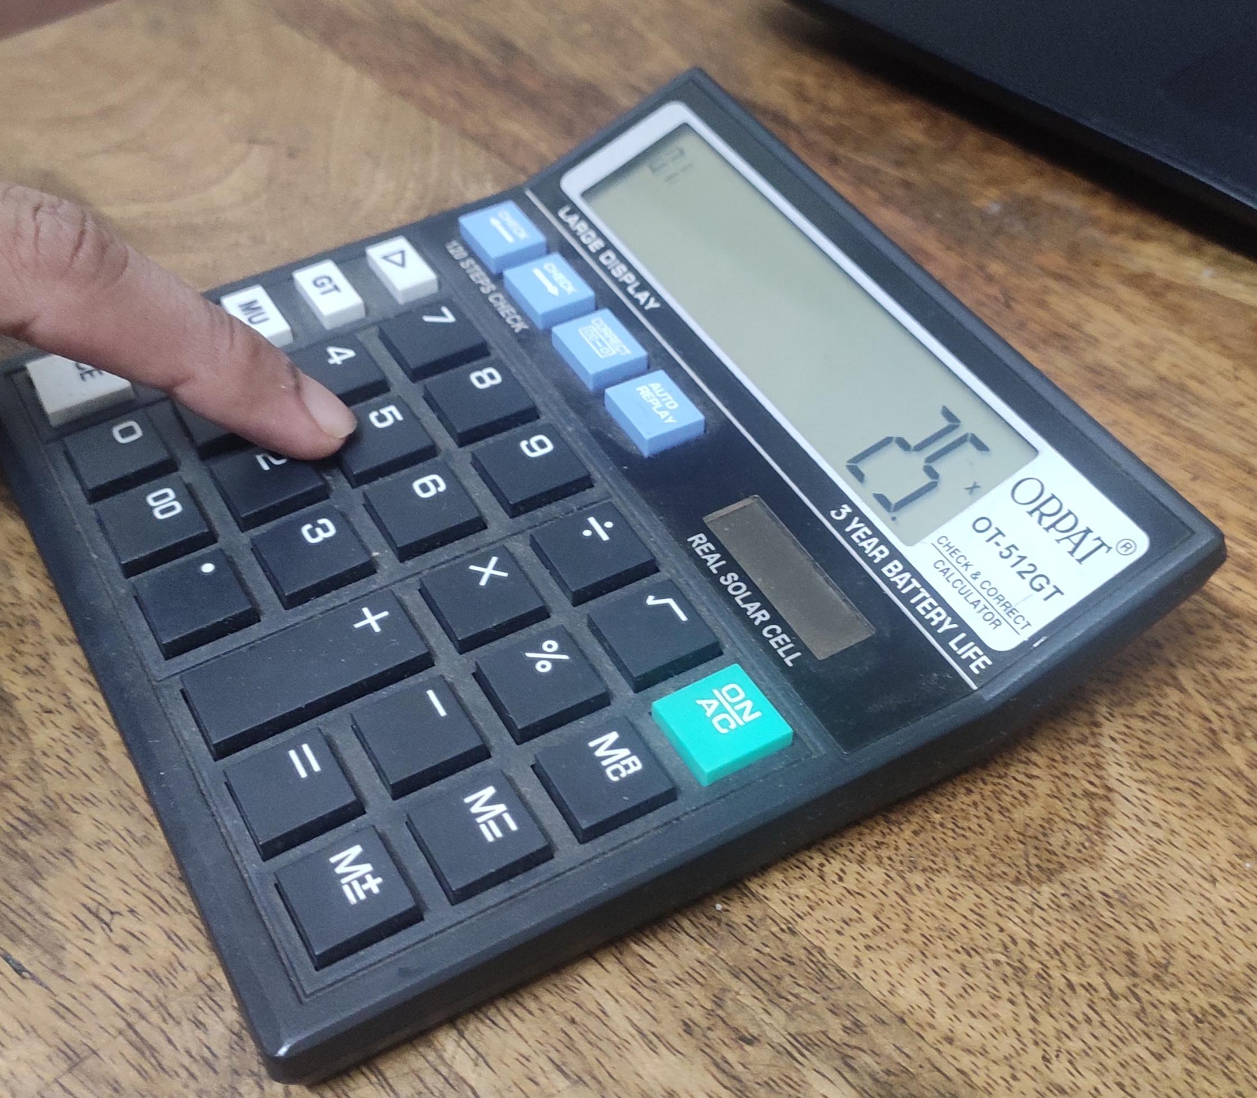
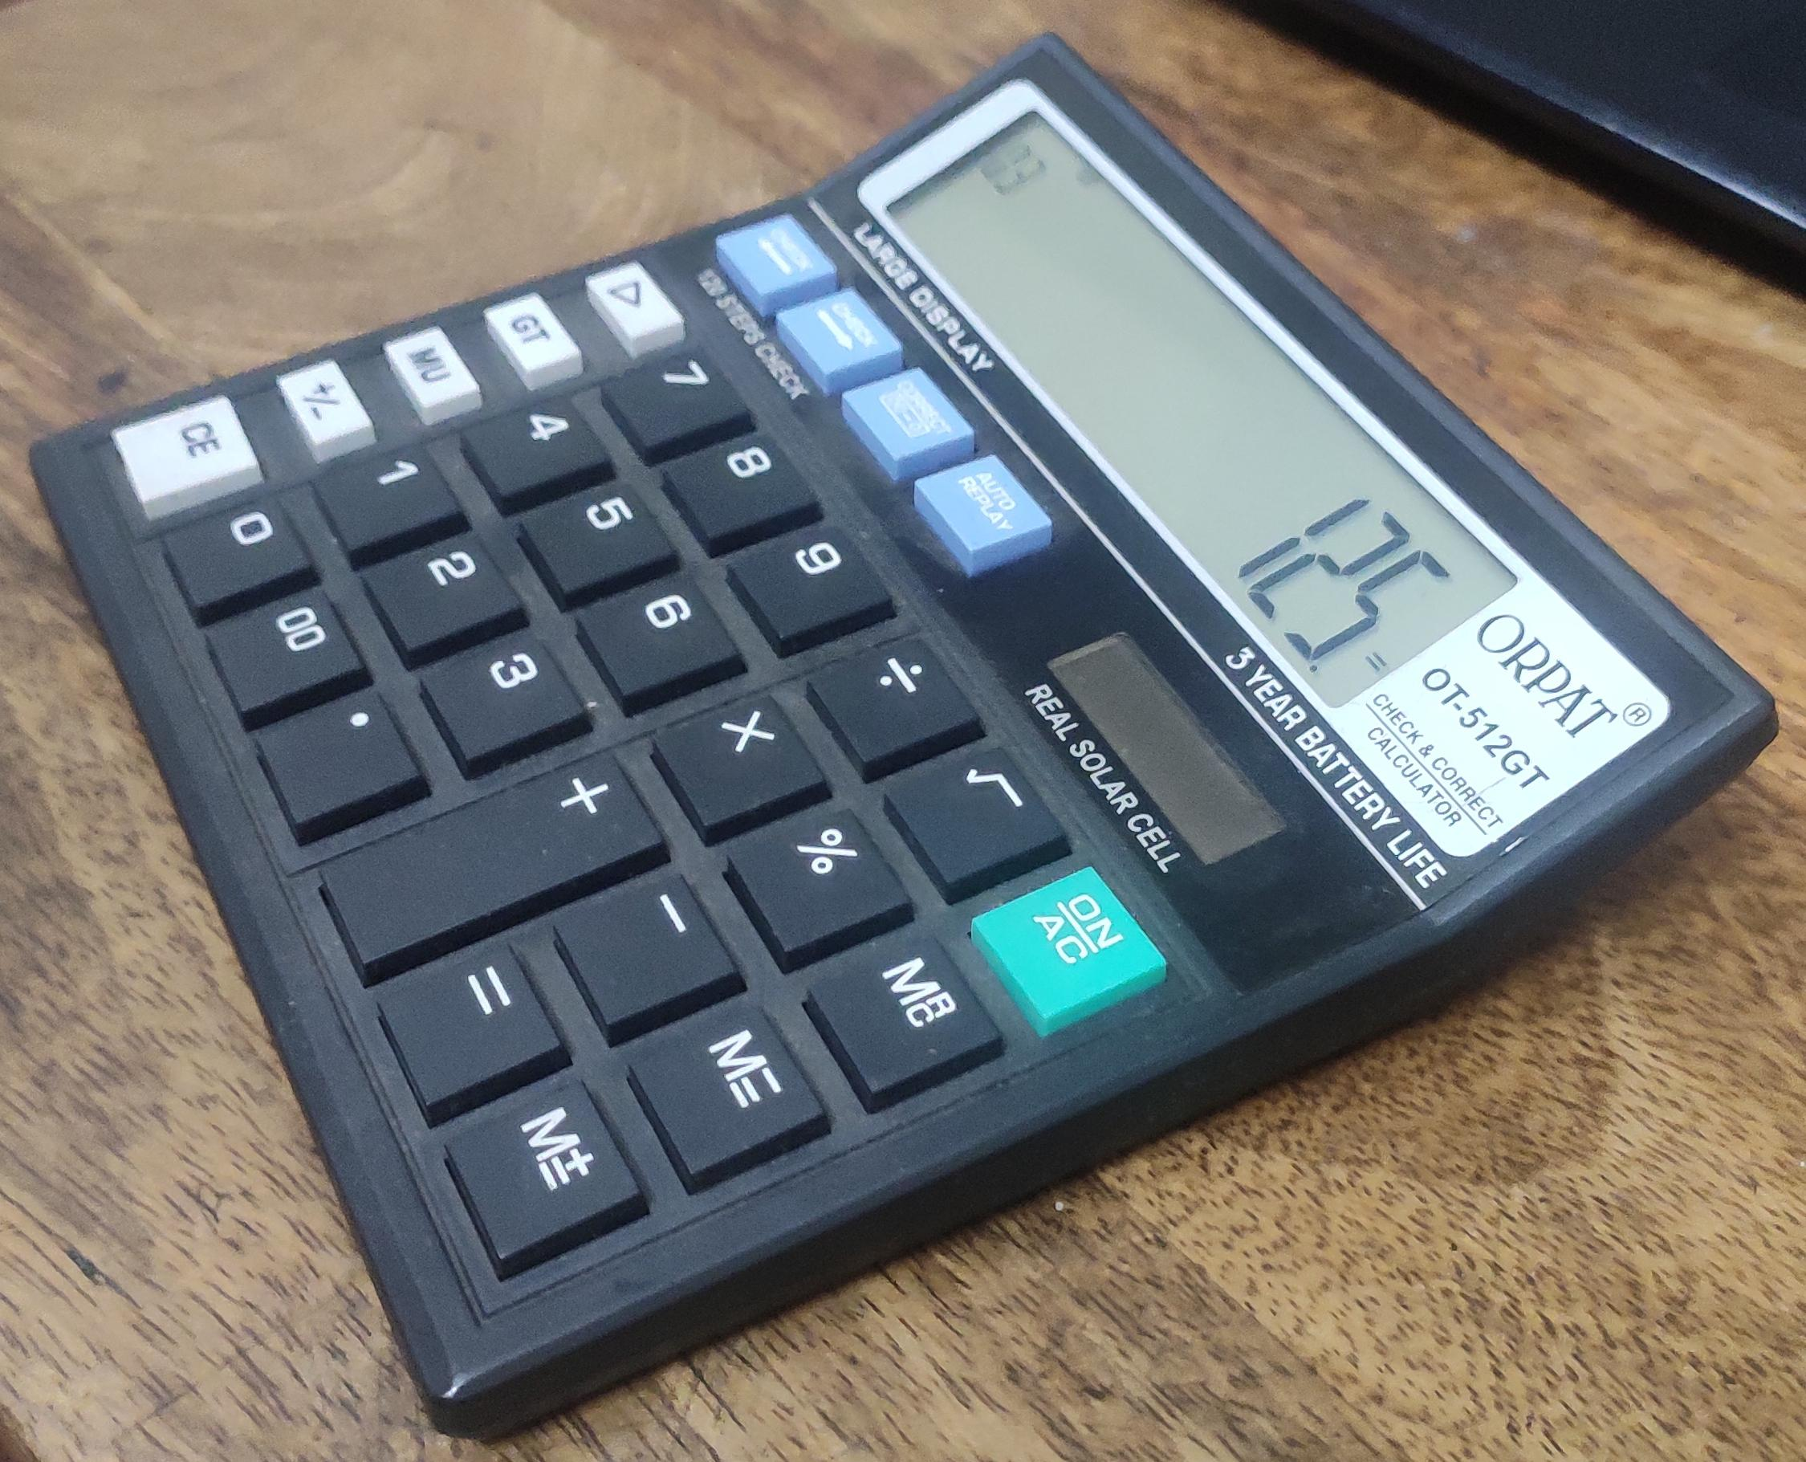


Input and Output
Calculator processes input
Process input
Get
input()
Output
print()

Slide 6
Python Variables
Variables are basically containers for storing data values
Based on the data type of a variable, the interpreter allocates memory and decides what can be stored in the reserved memory
The equal sign (=) is used to assign values to variables
Python does not need explicit declaration of variables
x
9
name
Example:
x = 9
name=”Nikita”
length = 7.14
LFC
length
7.14

Slide 7
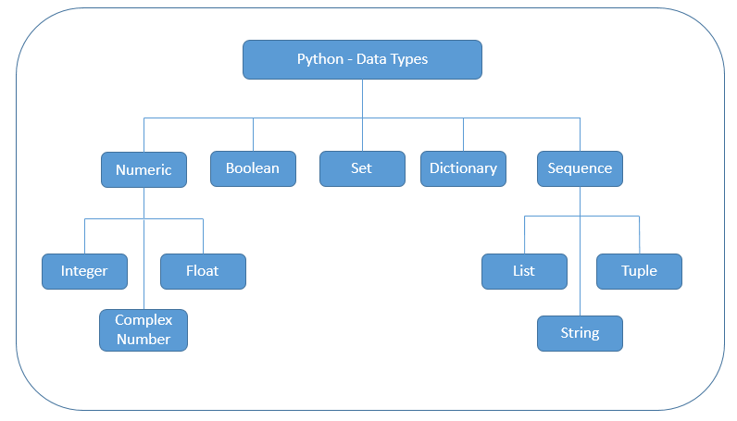
Python Data Types

Slide 8
Python Operators
+
>
%
Arithmetic Operators
Comparison (Relational) Operators
Assignment Operators
Logical Operators
Bitwise Operators
Membership Operators
Identity Operators
&
!=
==
*

Slide 9
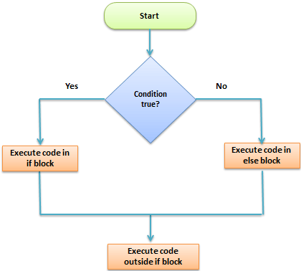

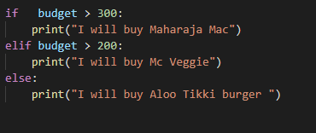
Conditional Statements (1/2)
Conditional Statement in Python perform different computations or actions depending on whether a specific Boolean constraint evaluates to true or false
There are 3 conditional statements -
if
else
elif

Slide 10
Conditional Statements (2/2)
If
Syntax: -
if condition:
#statement to be executed if it’s true
C. elif
Syntax: -
if (condition):
statement
elif (condition):
statement
.
.
else:
Statement
B. else
Syntax: -
if condition:
# Executes this block if
# condition is true
else:
# Executes this block if
# condition is false

Slide 11
Rock-Paper-Scissors Game
Steps: -
Import Random Function from python
Take input from user
Use if,elif,else for the main logic
Print the results

Slide 12

Any Questions?
?

